Slide 1


Digital Hearing Aid

Slide 2

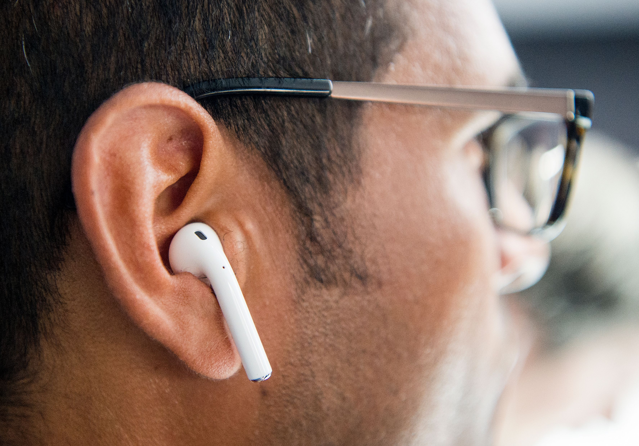
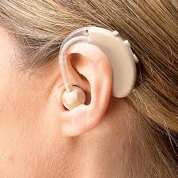
Digital Hearing aid
The reason for creating this.
Look

Slide 3
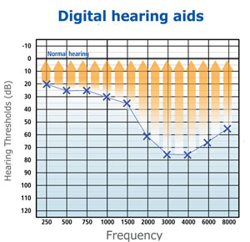
Digital Hearing aid
The reason for Digital Hearing Aid.
Technology

Slide 4

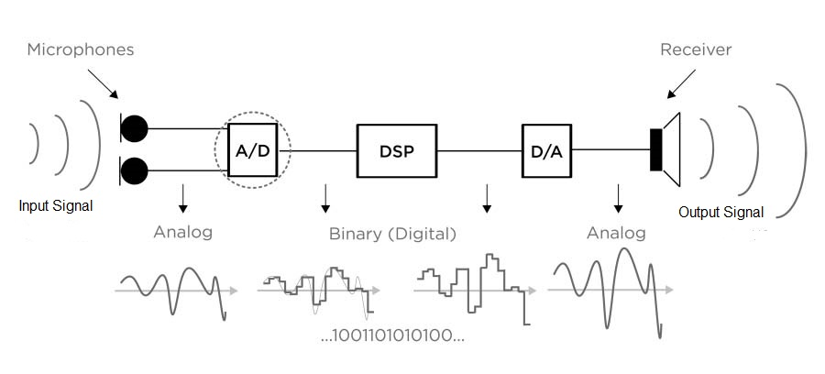
process

Slide 5

2 Product
Materials used for final invention build
Why did you choose those materials?

